Slide 1

Deploying Airflow with K8S Executors and Rancher
Notes:
https://courses.cs.washington.edu/courses/cse403/13au/lectures/git.ppt.pdf
http://enos.itcollege.ee/~jpoial/allalaadimised/git/getting-started-with-git.pdf

Slide 2
Deploying Airflow with K8S Executors & Rancher
Quick overview of EKS
Set up an EC2 instance for Rancher
Create an IAM User with permissions
Create an ECR repository
Create an EKS cluster with Rancher
How to access applications from the outside?
Deploy Nginx Ingress with Catalogs (Helm)
Deploy and run Airflow with the Kubernetes Executor on EKS

Slide 3

Overview of AWS EKS
AWS EKS (Elastic Kubernetes Service)
Makes easy to deploy, manage and scale containerized applications
Orchestrate your containers
Still need to configure subnets, VPS, IAM roles, SSH keys...
Integrated with AWS services (ECR, ELB, IAM, ...)

Slide 4
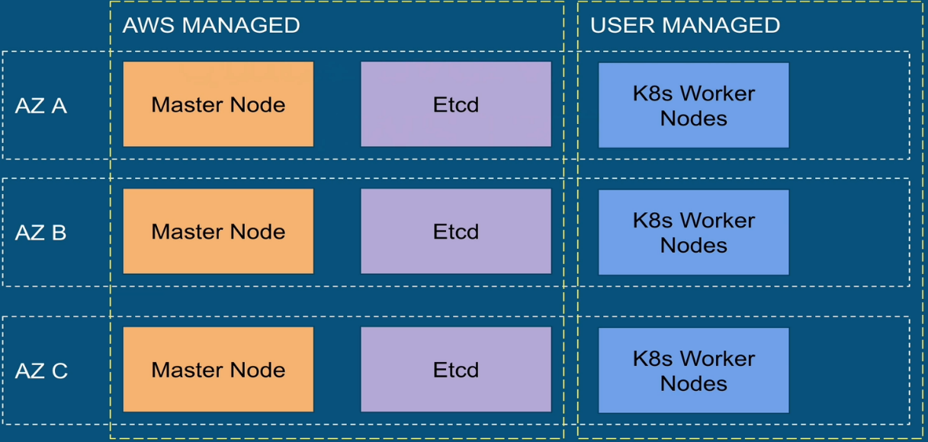
Overview

Slide 5
Access applications from outside
Service, Load Balancer, Ingress

Slide 6
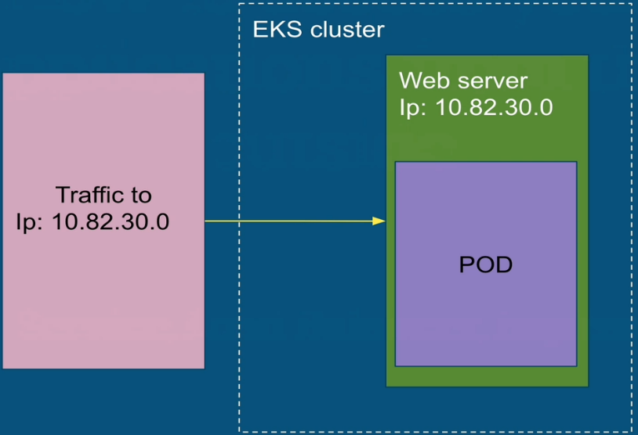
The Issue

Slide 7
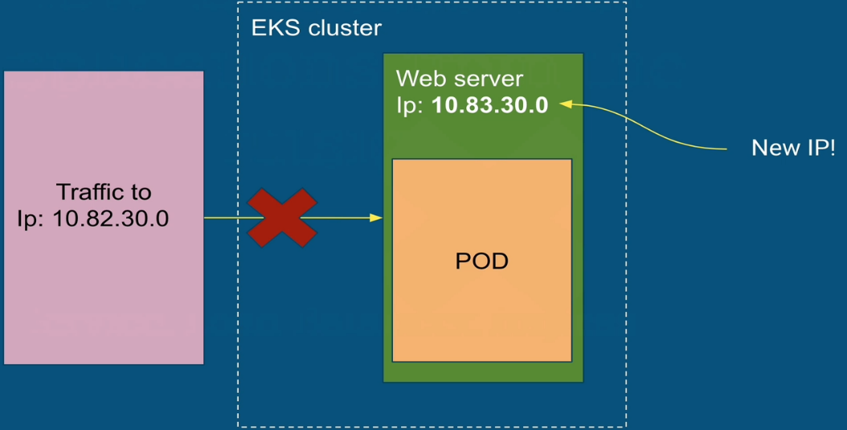
The Issue

Slide 8
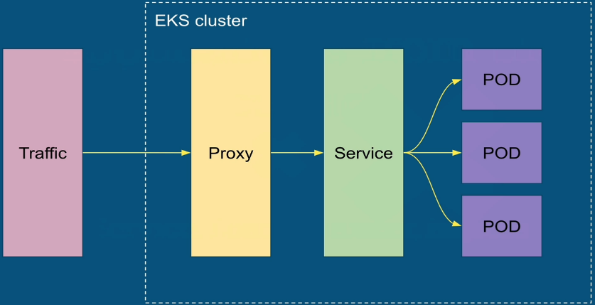
ClusterIP

Slide 9
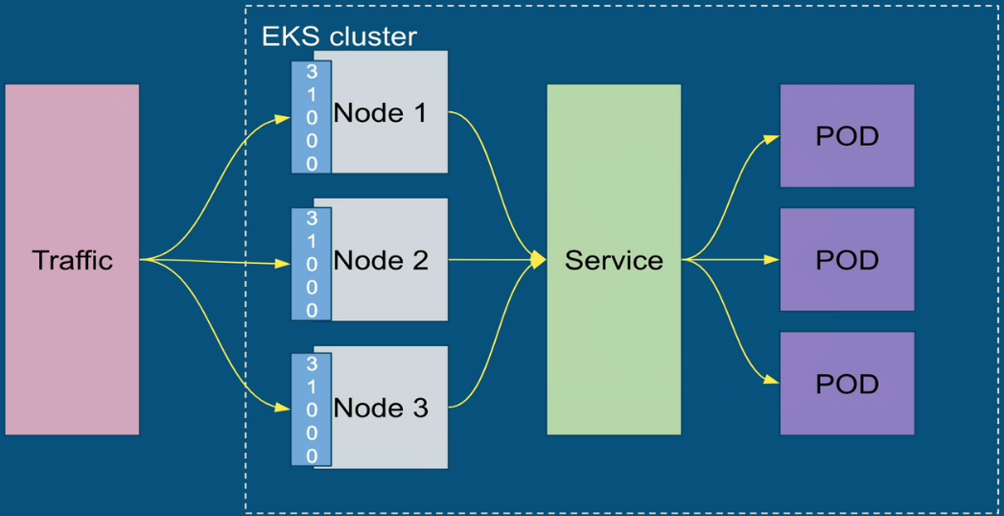
NodePort

Slide 10
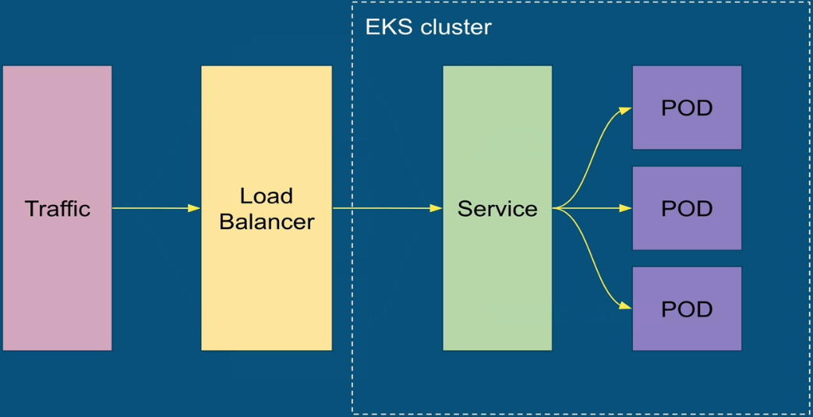
Load Balancer

Slide 11
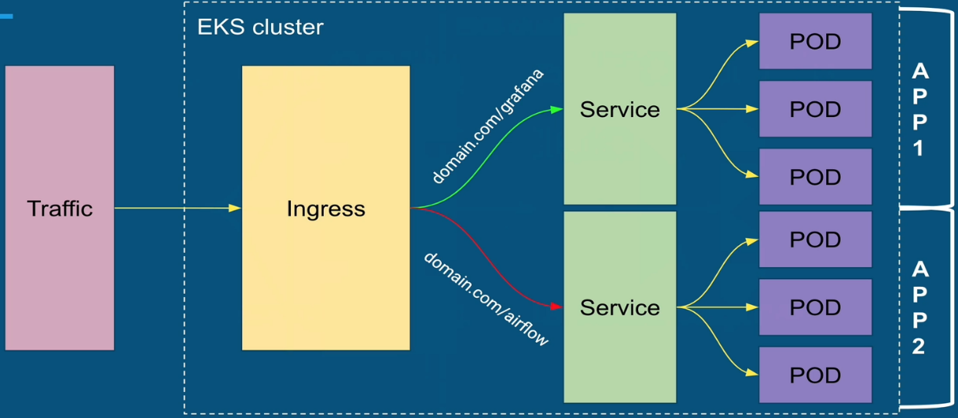
Ingress

Slide 12
Thanks

